Slide 1


Quantum Communications Group
Weekly report
Group Coordinator:
Armando Nolasco Pinto
anp@ua.pt
Group Websites:
https://www.it.pt/Groups/Index/72
LinkedIn: https://www.linkedin.com/company/quantum-communications-group-it-av/

Slide 2
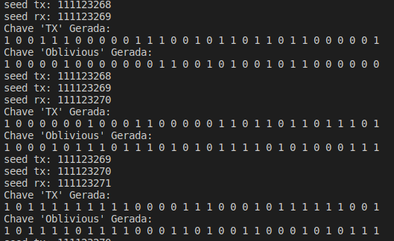
Recon_Emulator – Oblivious Keys
The Recon_Emulator is a block capable of generating Oblivious and Symmetric Keys and saving them to a file
The Oblivious Keys are generated based on 2 Seeds and 2 RNG( Random Number Generator)
The first Seed (tx_seed) is inputted by the user as an Unsigned Int at his choice.
This seed is used for generating a Random Tx Key through the first Random Number Generator
The second Seed (rx_seed) is based on the tx_seed ( rx_seed = tx_seed + 1)

Slide 3
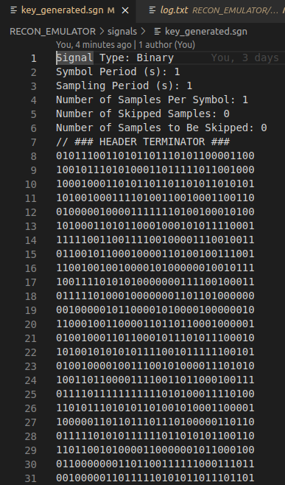
Recon_Emulator – Oblivious Keys
To generate the oblivious key, we are going to go through each pair of bits and then the second RNG,based on the rx_seed, is going to select one of the bits for the key.
The value of the bit is going to be saved on the position of the second bit and the position number (first position - 0 / second position - 1) of the selected bit is going to be the first bit
After the first run, tx_seed = tx_seed + 1

Slide 4
Recon_Emulator – Symmetric Keys
For the symmetric keys the tx_seed is the most important.
The keys are going to be generated through a RNG originated with the respective seed

Slide 5
Recon_emulation - Input Parameters
ReconciliationApp Emulator
Input Parameters: Key Type: Symmetric/Oblivious
File Type: ASCII/Base64
Counter First Value: 0
Counter Last Value: max_int
Tx files name: keys [[sym_tx/obl_tx.[dat/b64]]
Rx files name: keys [[sym_rx/obl_rx.[dat/b64]]
Seed: 0
//------------INPUTPARAMETERS-------------
//
//--------GENERAL CONFIGURATION-------
keyType=0
fileType=0
asciiFileNameTailNumberModulos=0
txFileName=sym_tx
rxFileName=sym_rx
seed=0

